Slide 1
WELCOME TO
DATA STRUCTURE

Slide 2
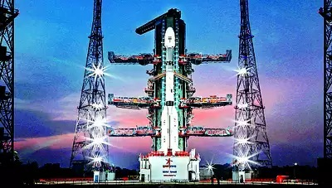


ISRO DATA ANALYSIS
WITH POWER BI

Slide 3
